Slide 1
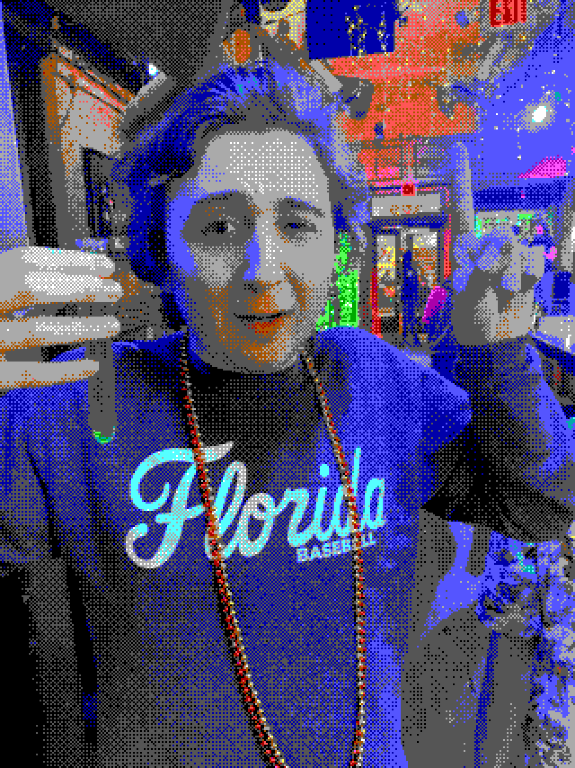
Who is this, in EGA?

Slide 2
Answer: John, at a bar, holding a shot

